Slide 1

Digital signature recognition using Mobilenet
by
Dakshayani K
Roll No. 214G1A3318
Bharathi A
Roll No. 214G1A3310
Aasritha R
Roll No. 214G1A3301
Chandan Kumar G
Roll No. 214G1A3313
Under the guidance of
Dr. D. Rajesh Babu _{M.Tech., Ph.D.}
Assistant Professor
Department of Computer Science and Engineering (AI & ML)
Srinivasa Ramanujan Institute of Technology
(Affiliated to JNTUA & Approved by AICTE) (Accredited by NAAC with ‘A’ Grade & Accredited by NBA (EEE, ECE & CSE)
Rotarypuram Village, B K Samudram Mandal, Ananthapuramu – 515701.
2024 - 2025

Slide 2
Contents
Introduction
System Design
Implementation
Sample code

Slide 3
Introduction
This project aims to develop a robust handwritten signature classification system by ingeniously integrating Convolutional Neural Networks (CNN) with the Mobile Net architecture.
The objective is to leverage the powerful feature extraction capabilities of CNNs, and the lightweight and efficient characteristics of Mobile Net, to create a model that is both accurate and resource-efficient.
Furthermore, the study seeks to employ transfer learning and data augmentation techniques to improve the model's performance, making it adaptable and effective in handling the diverse and challenging nature of handwritten signatures.

Slide 4
Introduction
Applications
1. Banking & Finance
Digital Signature Verification → Used in online banking to verify customer signatures.
Fraud Detection → Detects forged or altered signatures in financial transactions.
Cheque & Document Authentication → AI-based validation for signed bank cheques and agreements.
2. Legal & Government Services
E-Governance & Digital Contracts → Verifies electronic signatures on government documents.
Legal Document Verification → Ensures signature authenticity on legal papers.
Voting & Election Systems → Secure signature verification for voter identification.

Slide 5
Introduction
3. Education & Examination Systems
Automated Student Verification → Confirms student identity in online exams.
Certificate Authentication → Validates signatures on academic documents.
Paperless Admission Process → Uses AI for digital signature verification.
4. Healthcare & Medical Records
Electronic Health Records (EHR) → AI verification of patient and doctor signatures.
Prescription Validation → Ensures authorized medical prescriptions.
Insurance Claim Authentication → Reduces fraud in medical insurance processing.

Slide 6
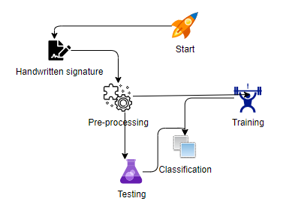
System Design

Slide 7
System Design
Start
The process begins when a user submits a handwritten signature for verification.
Handwritten Signature
The input to the system is a scanned or digital signature image.
Pre-processing
Objective: Prepare the signature image for training and classification.
Training
A deep learning model (CNN + MobileNet) is trained using a dataset of genuine and forged signatures.

Slide 8
System Design
Classification
Once the model is trained, it classifies an input signature into:
✅ Genuine Signature – If it closely matches a registered pattern.
❌ Forged Signature – If there is a significant deviation
Testing
The trained model is tested on new signatures to evaluate its accuracy.

Slide 9
System Design
Algorithms Used
Convolutional Neural Networks (CNNs) – Used for feature extraction from images of signatures.
MobileNet – A lightweight deep learning model optimized for mobile and edge devices.

Slide 10
System Design
K-Nearest Neighbors (KNN) – Can be used as a baseline classification method for signature matching.
Random Forest – Sometimes used for feature selection or ensemble learning.
Recurrent Neural Networks (RNNs) or LSTMs – If temporal data is considered in signature dynamics.
Support Vector Machine (SVM) – Often used for classification tasks in signature verification.
Latent Diffusion Models (LDMs) – Used for generating images and videos from text prompts.

Slide 11
Implementation
Technologies :
Python, TensorFlow, PyTorch – For deep learning model training.
OpenCV – For preprocessing and machine learning classification.
Flask, FastAPI – For web-based implementation.
Edge Devices (Raspberry Pi, Mobile Phones) – Deployment of lightweight models.

Slide 12
Implementation
HARDWARE & SOFTWARE REQUIREMENTS
Operating System : Windows 7/8/10
Server side Script : HTML, CSS, JS
Programming Language : Python
Libraries : Flask, Pandas, Mysql.connector, Os, Smtplib, Numpy
IDE/Workbench : PyCharm
Technology : Python 3.6+
Server Deployment : Xampp Server

Slide 13
Implementation
Database : MySQL
Processor : I3/Intel Processor
RAM : 8GB (min)
Hard Disk : 128 GB
Key Board : Standard Windows Keyboard
Mouse : Two or Three Button Mouse
Monitor : Any

Slide 14
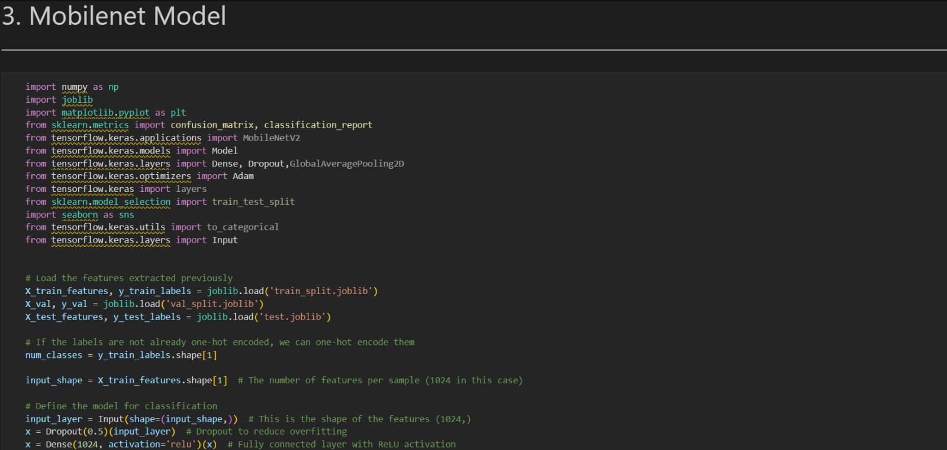
Sample Code

Slide 15
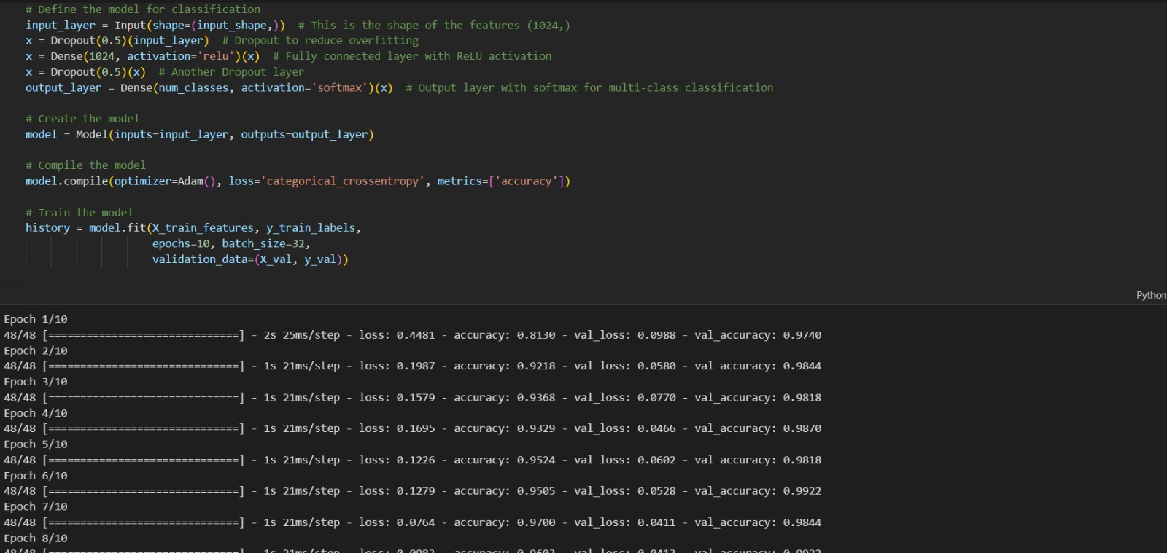
Sample Code

Slide 16
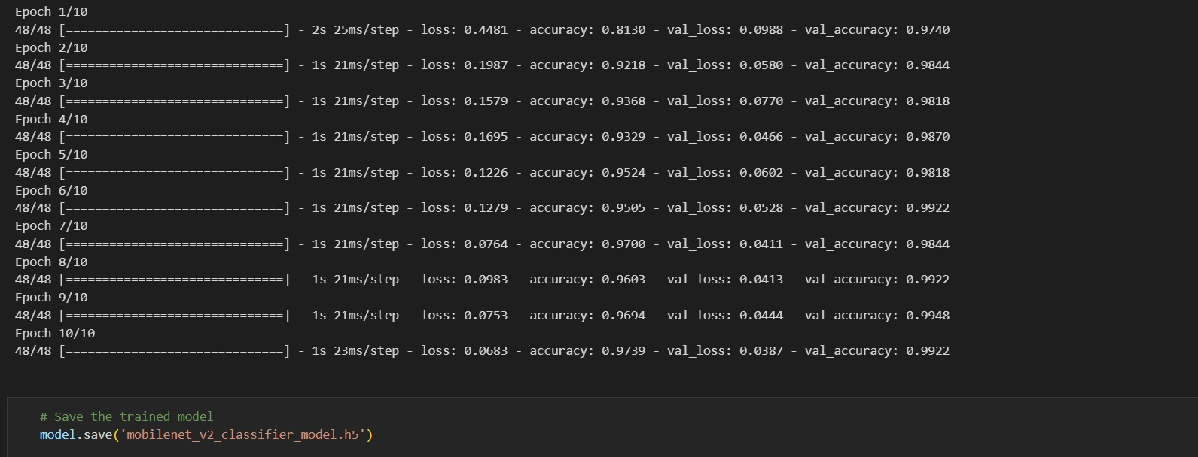
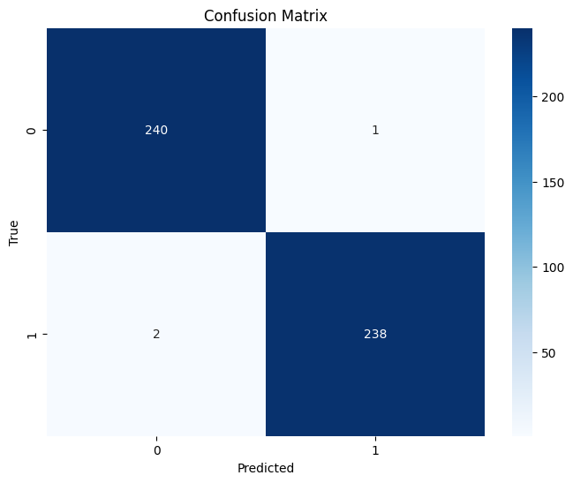
Result

Slide 17
Any Queries?

Slide 18
Thank You!!!

